Slide 1

Pizza Sales – Data Analysis
An analytical overview on Pizza Sales dataset

Slide 2
I. Introduction
This project explores the Pizza Sales dataset to uncover patterns and factors affecting Pizza Sales. The dataset includes detailed records that related to pizza sales and other affecting factors.
In this project, we analyse this dataset using Python libraries such as Pandas, NumPy, and Matplotlib/Seaborn.
Objectives:
  Explore dataset structure
  Perform cleaning and pre-processing
  Generate insights from data
  Visualize important trends

Slide 3
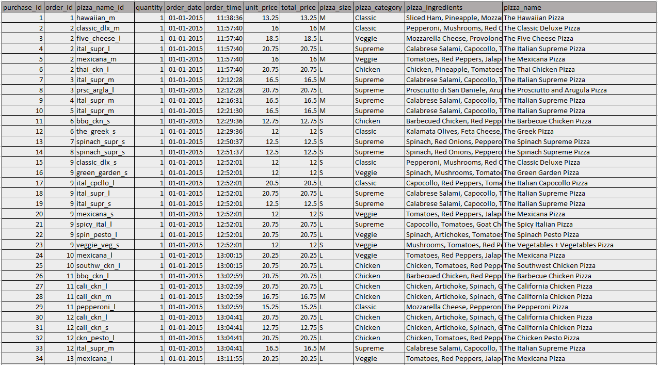
II. Dataset Description
Data is an important source of information in any kind of project as it allows the analyst to build relationships between what is happening in different measures and categories.
Details:
  Total Rows: 48620
  Total Columns: 12
  Data Format: CSV
  Number of Files: 1

Slide 4
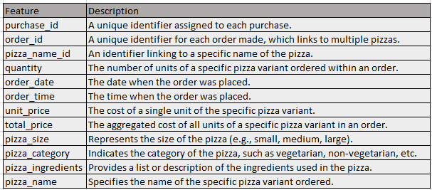
II. Dataset Description

Slide 5
III. Data Cleaning
For data cleaning purposes, we used different techniques based on our scenario which are explained in-depth as follows:
Details:
  1. Checking the Null values
  2. Check for duplicates
  3. Standardize the Data

Slide 6
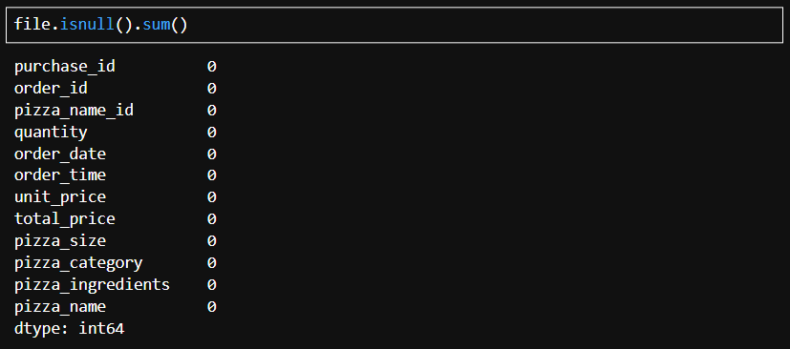
1. Checking the Null values
No null values found in this dataset.

Slide 7
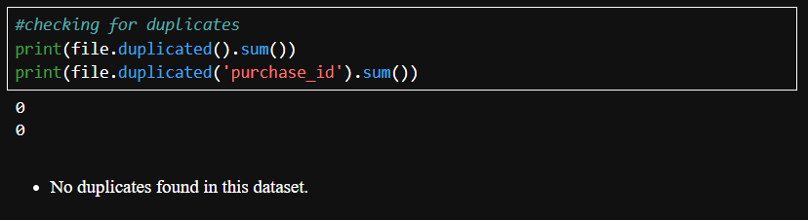
2. Checking the Duplicate values
No duplicates found in this dataset.

Slide 8
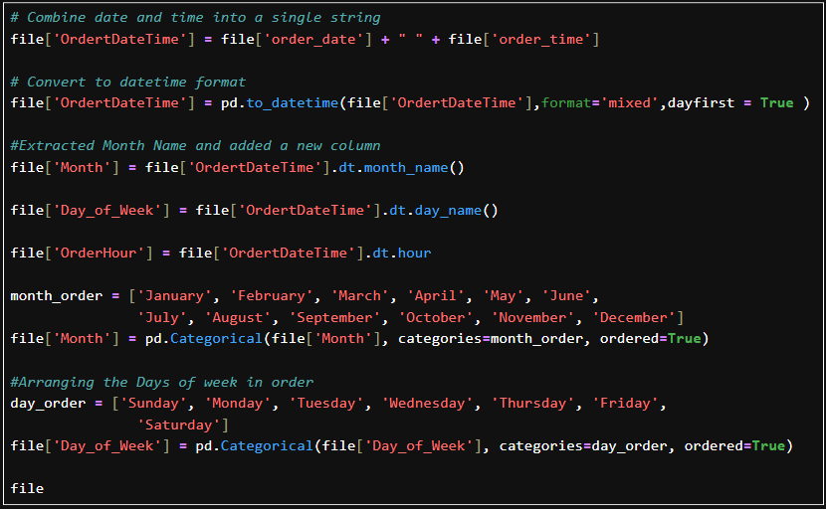
3. Standardize the Data
Here we can see that many of the data columns are not in appropriate data type. So convert into proper type.
And create columns for month and day of week

Slide 9
IV. Exploratory Data Analysis
For data analysis purposes, I followed the below steps to analyse the data and provide insights and visualise.
Activities:
  Summary Statistics
  Analysis Visualizations
  Providing Insights

Slide 10
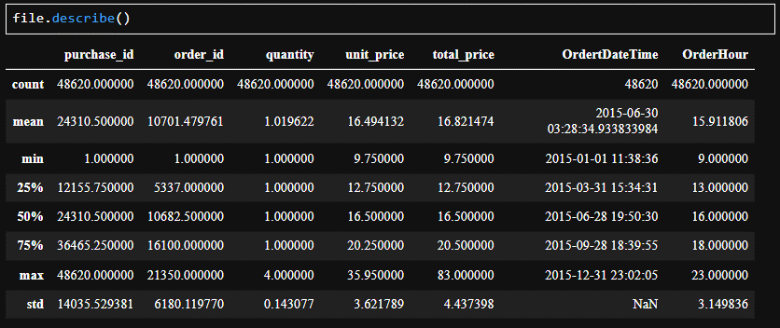
A. Summary Statistics
To know min and max values.
To check is there any outliers
To know the range of distribution

Slide 11
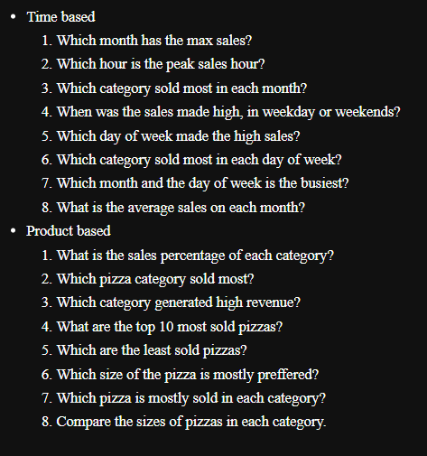
B. Analysis of the Data
To analyse and get insights, framed question based on Time and Product.
By finding the answer, we can get the insights

Slide 12
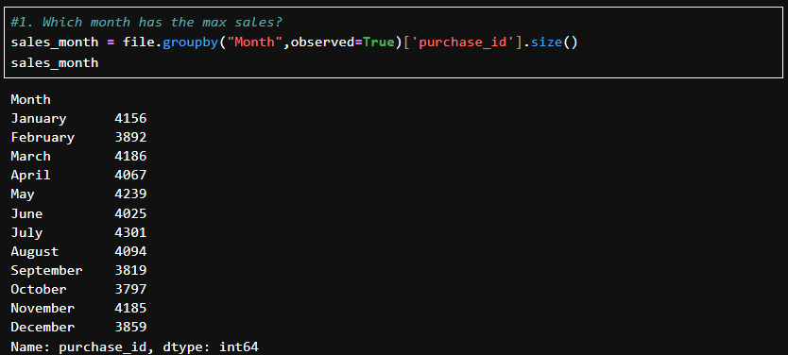
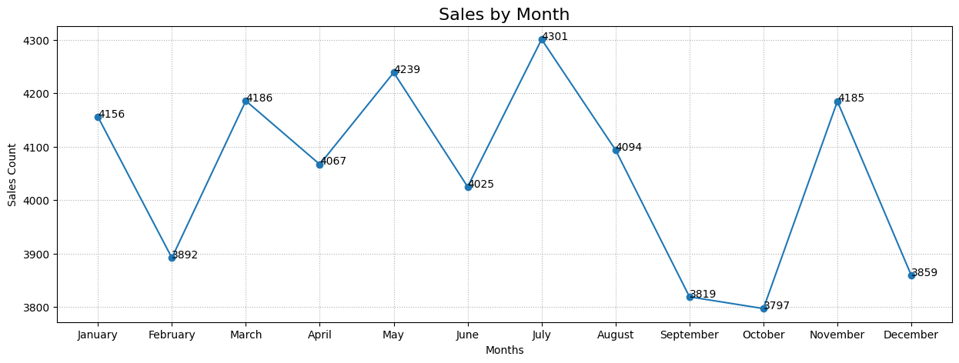
1. Which month has the max sales?
A. Time Based Analysis
The max sales was made in July Month(4301).
October is the least sales made month(3797) but not a huge difference.

Slide 13
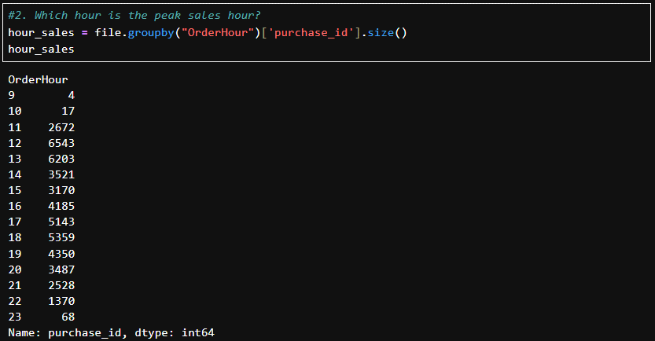
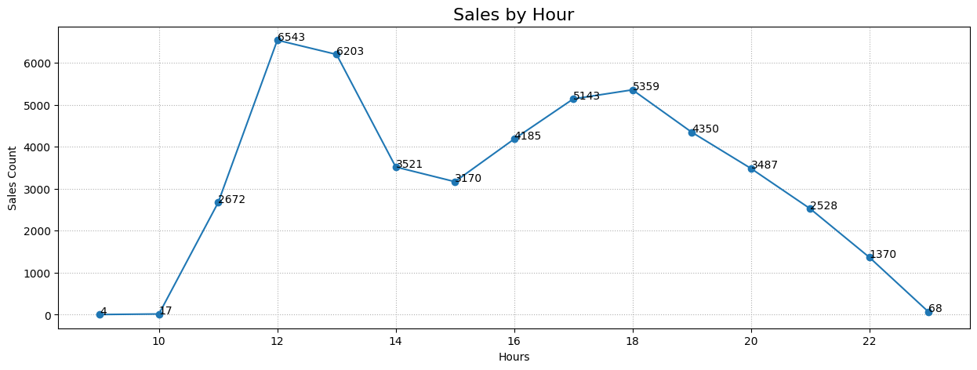
2. Which hour is the peak sales hour?
The sales was peak between the hours 12 to 1 pm which is basically a lunch time.
And again the sales was high between the hours 5 to 6 pm which is basically a break time.

Slide 14
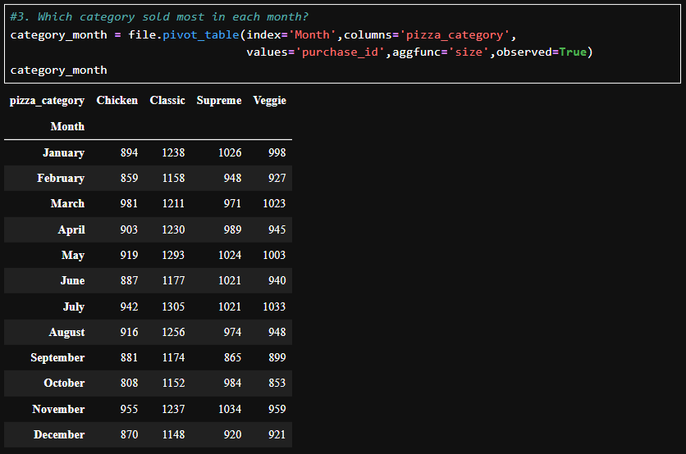
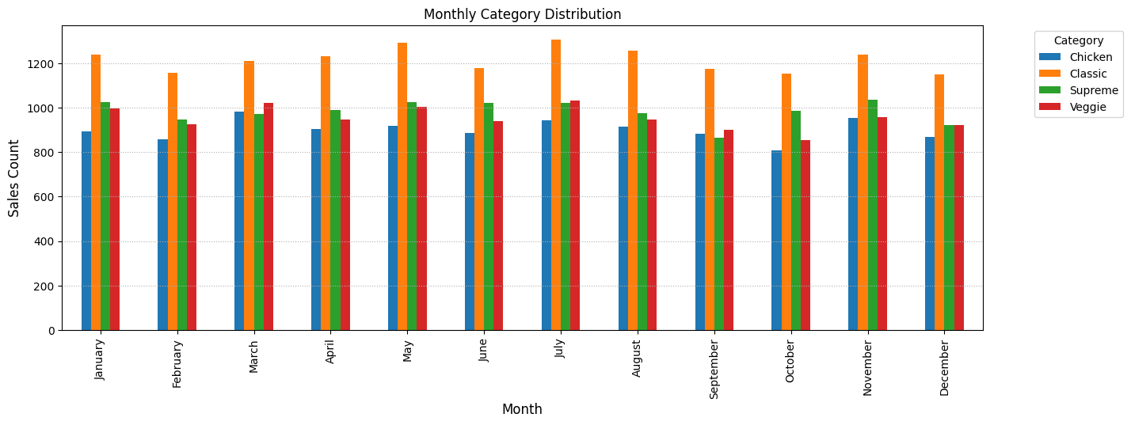
3. Which category sold most in each month?
The above visual clearly shows that on every month, 'Classic' category pizzas were sold most.
Among these months, 'July' is the most sales made month.

Slide 15
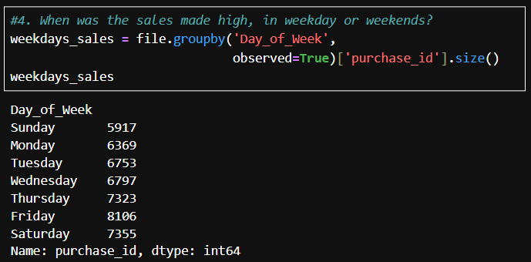
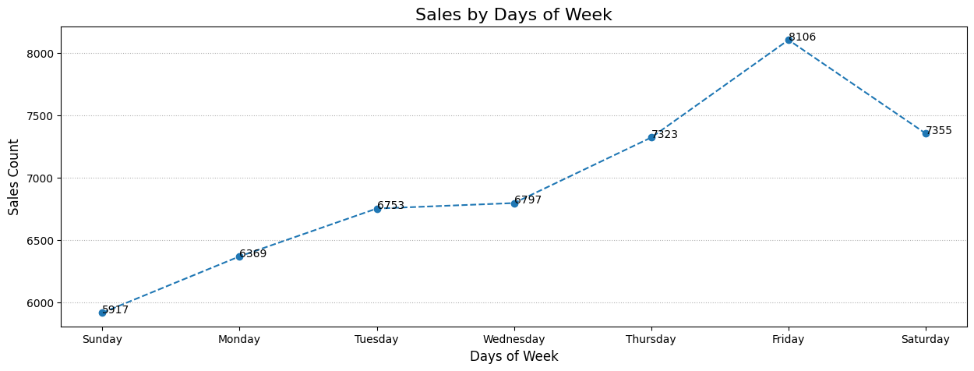
4. When was the sales made high, in weekday or weekends?
The highest sales was made on Fridays(8106) which is a weekday.
And we have to notice that 'Sundays' made the low sales in weeks.

Slide 16
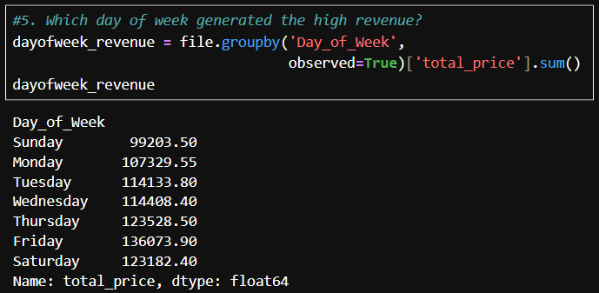
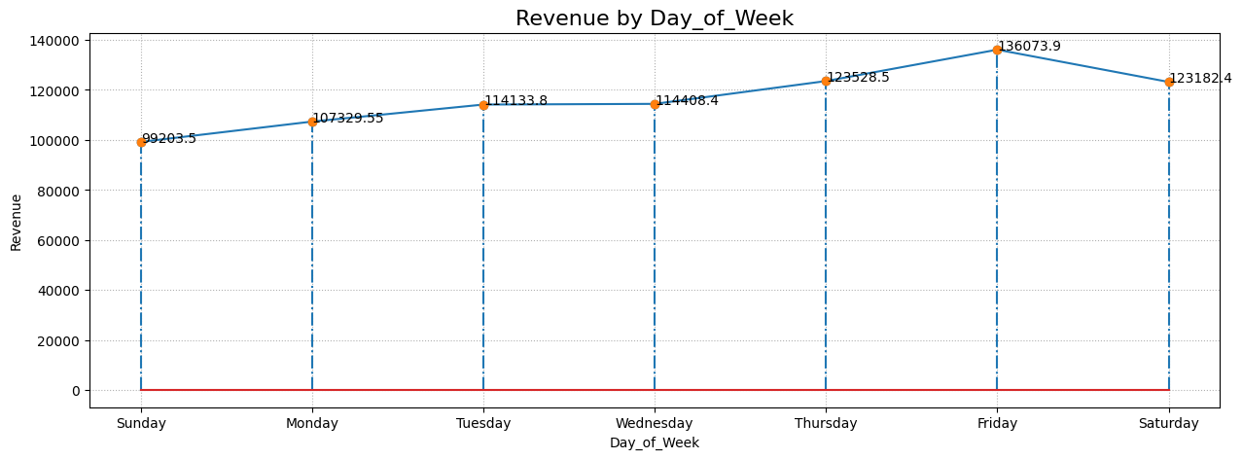
5. Which day of week generated the high revenue?
The max revenue was generated on Fridays(136073.90) which is a weekday.
And we have to notice that 'Sundays'(99203.50) made the low sales revenue in weeks.

Slide 17
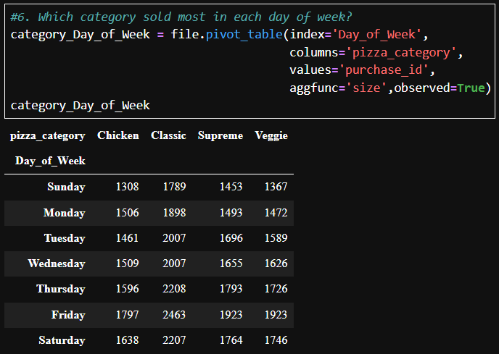
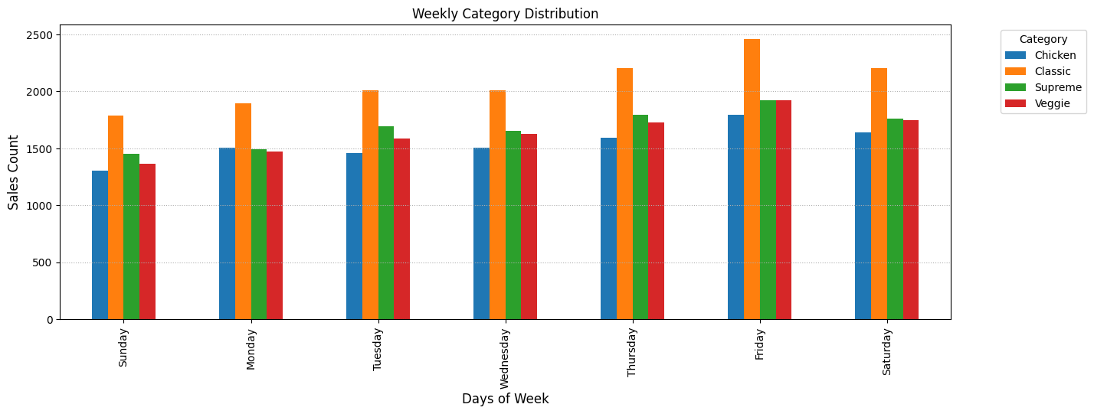
6. Which category sold most in each day of week?
The above visual clearly shows that on every day of week, 'Classic' category pizzas were sold most.
Among the days, 'Friday' is the most sales made day for 'Classic' category pizzas.

Slide 18
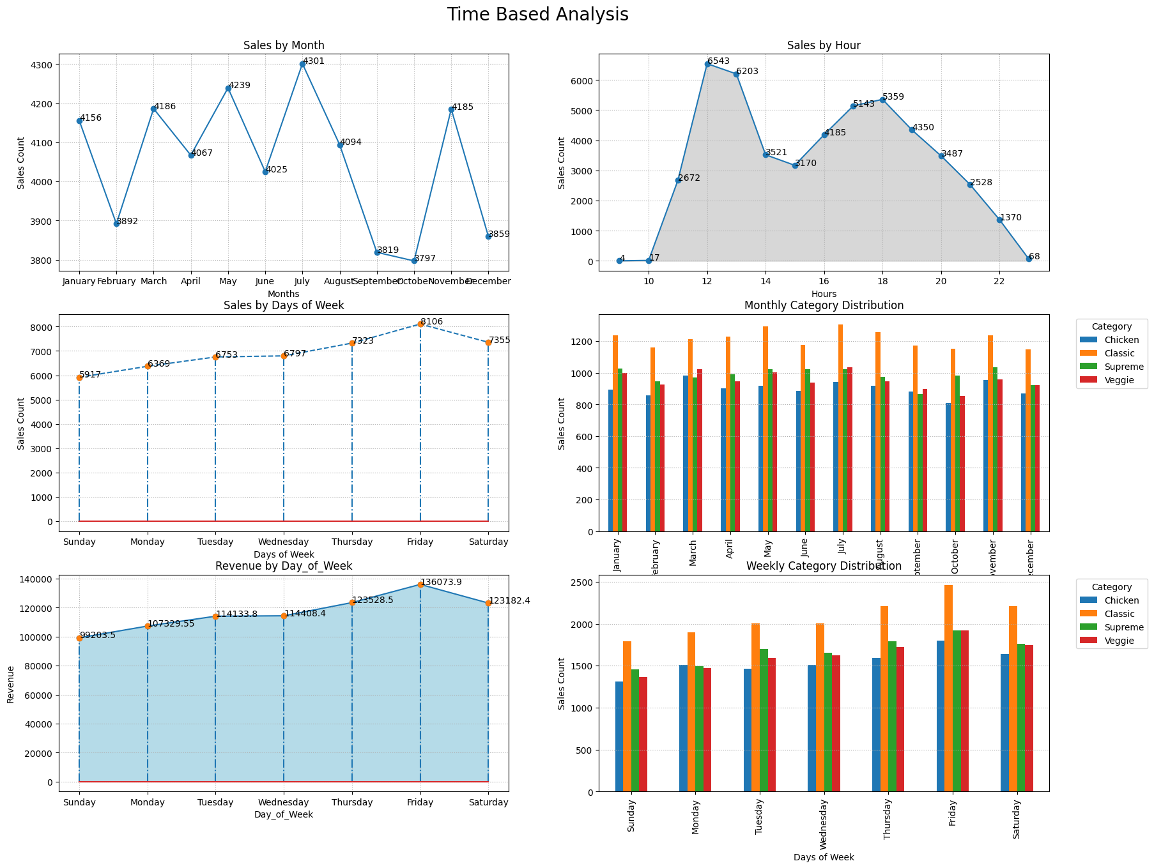
Time Based Analysis Insights:
The max sales was made in July Month(4301).
October is the least sales made month(3797) but not a huge difference
The sales was peak between the hours 12 to 1 pm which is basically a lunch time.
And again the sales was high between the hours 5 to 6 pm which is basically a break time.
The above visual clearly shows that on every month, 'Classic' category pizzas were sold most.
Among these months, 'July' is the most sales made month.
The highest sales was made on Fridays(8106) which is a weekday.
And we have to notice that 'Sundays' made the low sales in weeks.
The max revenue was generated on Fridays(136073.90) which is a weekday.
And we have to notice that 'Sundays'(99203.50) made the low sales revenue in weeks.
The above visual clearly shows that on every day of week, 'Classic' category pizzas were sold most.
Among the days, 'Friday' is the most sales made day for 'Classic' category pizzas.

Slide 19
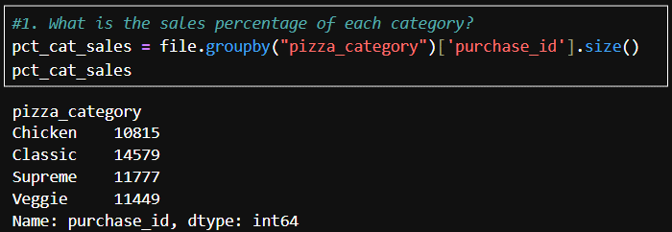
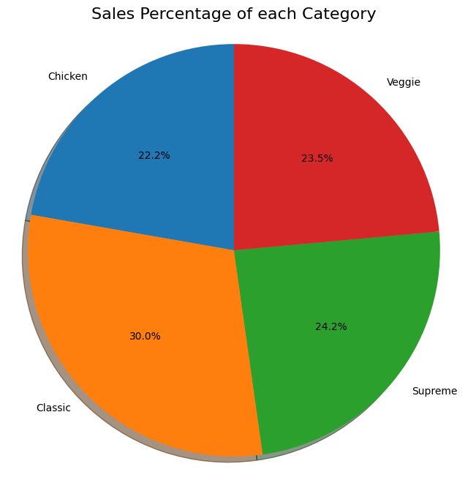
1. What is the sales percentage of each category?
A. Product Based Analysis
1st - Classic = 30%(14579)
2nd - Supreme = 24.2%(11777)
3rd - Veggie = 23.5%(11449)
4th - Chicken = 22.2%(10815)

Slide 20
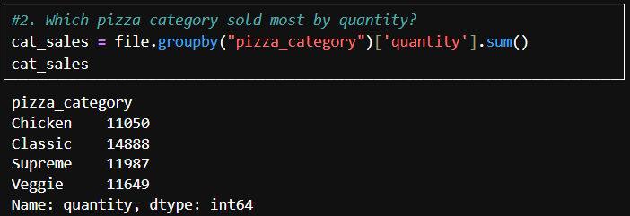
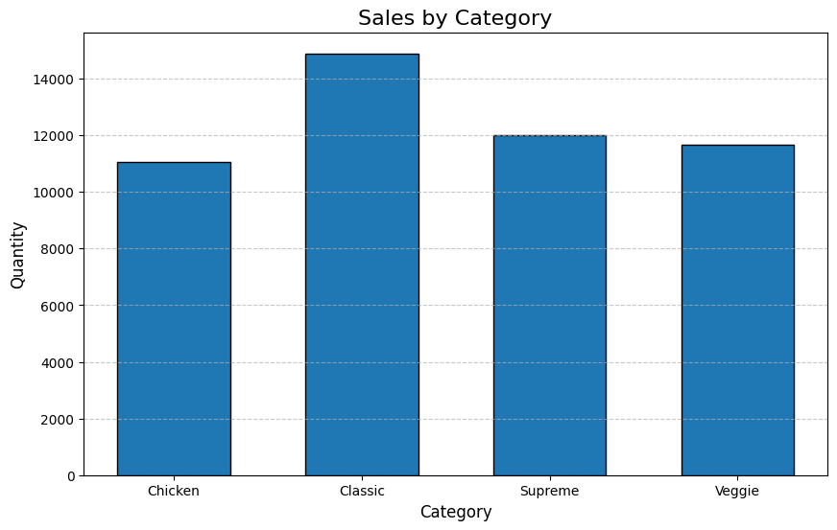
2. Which pizza category sold most?
Classic category pizzas were mostly sold(14888).
Chicken category pizzas were least sold(11050).

Slide 21
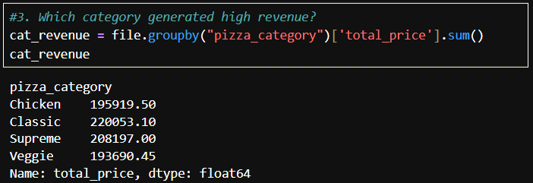
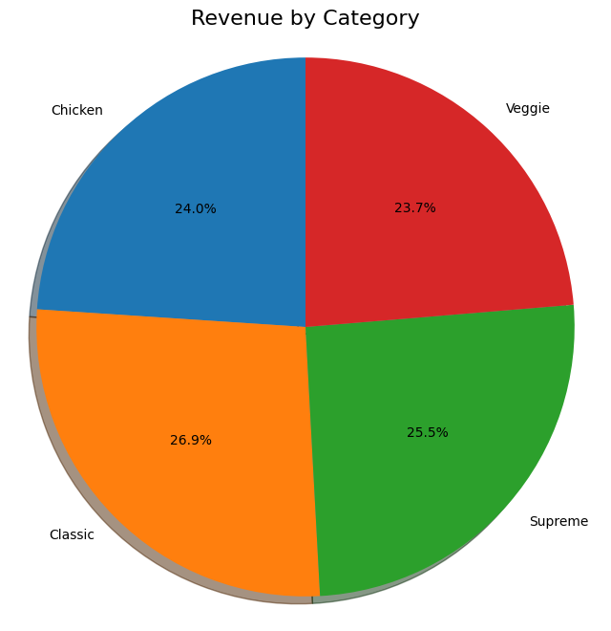
3. Which category generated high revenue?
Classic category pizzas were generated high revenue(220053.10).
Veggie category pizzas were generated low revenue(193690.45).

Slide 22
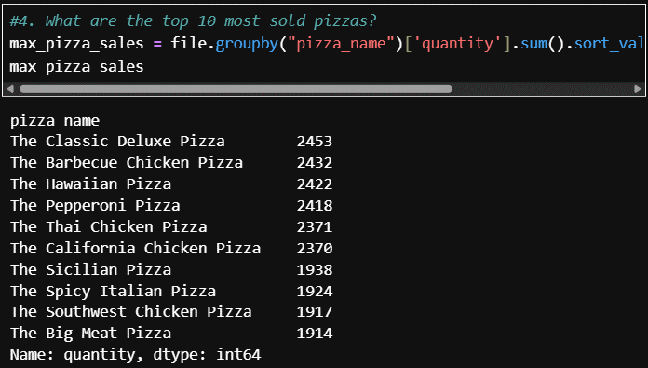
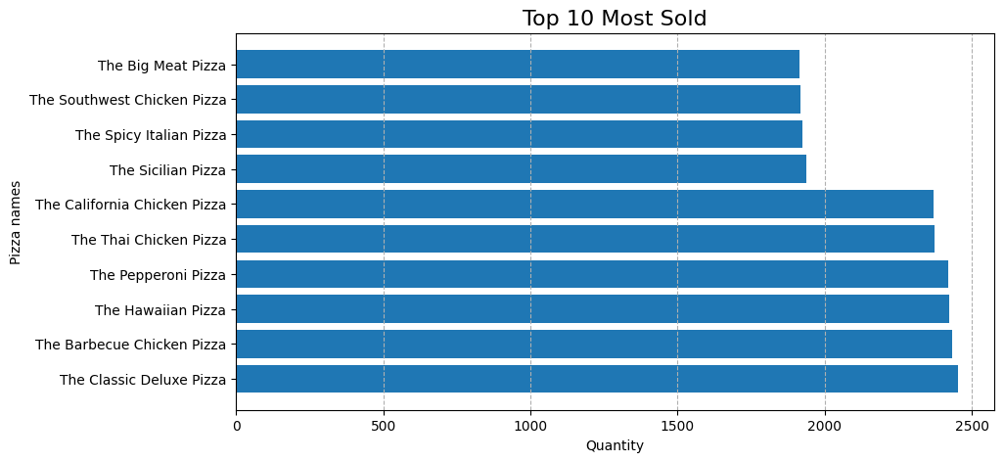
4. What are the top 10 most sold pizzas?
The Classic Deluxe Pizza = 2453
The Barbecue Chicken Pizza = 2432
The Hawaiian Pizza = 2422
The Pepperoni Pizza = 2418
The Thai Chicken Pizza = 2371
The California Chicken Pizza = 2370
The Sicilian Pizza = 1938
The Spicy Italian Pizza = 1924
The Southwest Chicken Pizza = 1917
The Big Meat Pizza = 1914

Slide 23
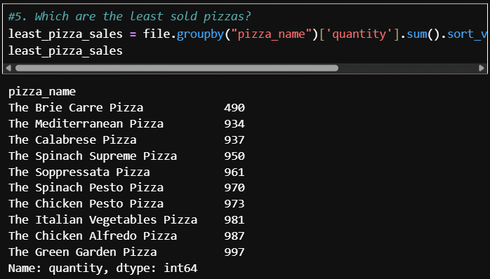
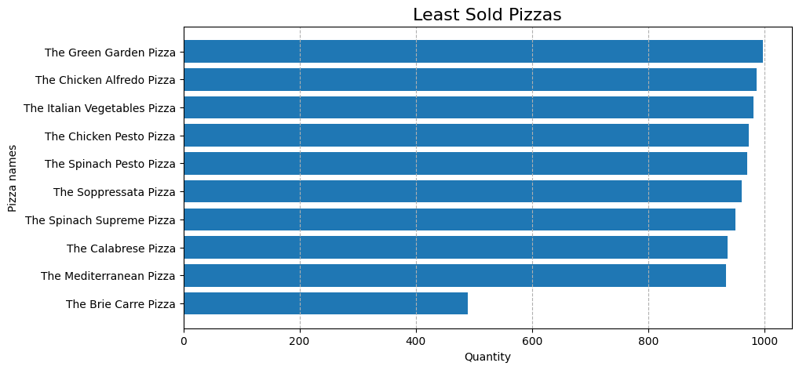
5. Which are the least sold pizzas?
The Brie Carre Pizza = 490
The Mediterranean Pizza = 934
The Calabrese Pizza = 937
The Spinach Supreme Pizza = 950
The Soppressata Pizza = 961
The Spinach Pesto Pizza = 970
The Chicken Pesto Pizza = 973
The Italian Vegetables Pizza = 981
The Chicken Alfredo Pizza = 987
The Green Garden Pizza = 997

Slide 24
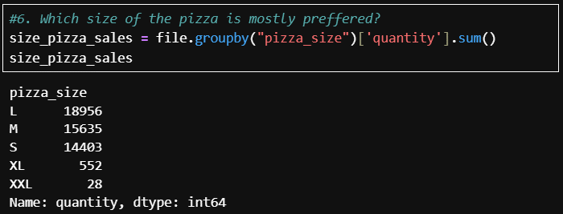
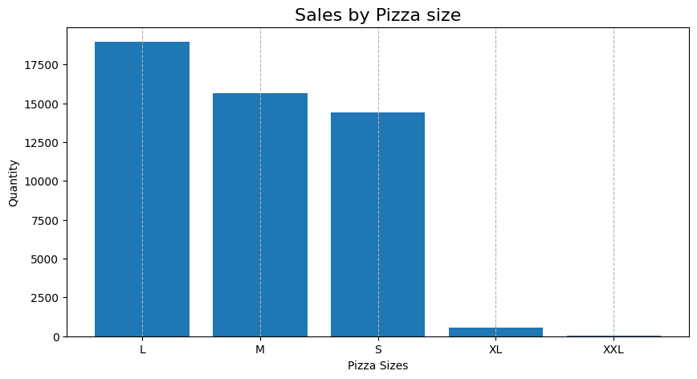
6. Which size of the pizza is mostly preferred?
'L' size pizzas were the most preferred pizza size(18956).
'XXL'(28) and 'XL'(552) size pizzas were the least preferred pizza size.

Slide 25
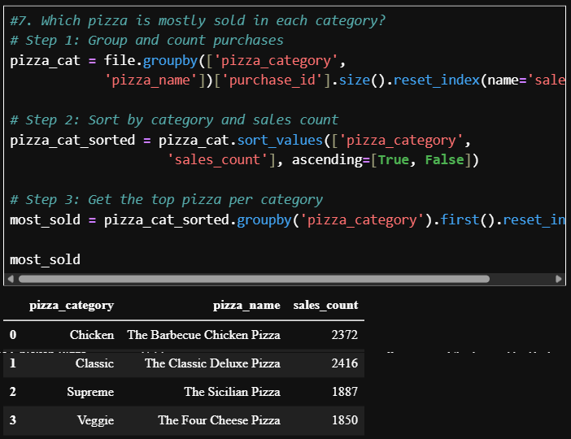
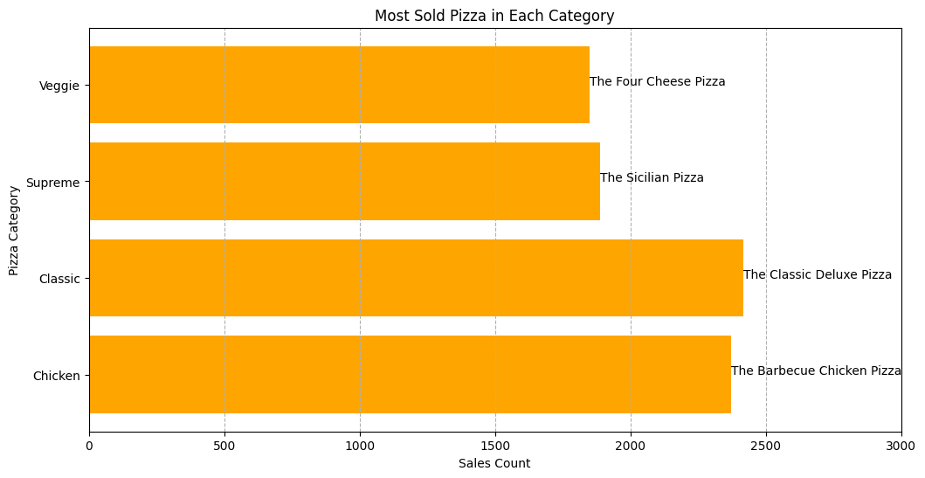
7. Which pizza is mostly sold in each category?
Most Sold Pizza in Each Category
  Chicken - The Barbecue Chicken Pizza - 2372
  Classic - The Classic Deluxe Pizza - 2416
  Supreme - The Sicilian Pizza - 1887
  Veggie - The Four Cheese Pizza - 1850

Slide 26
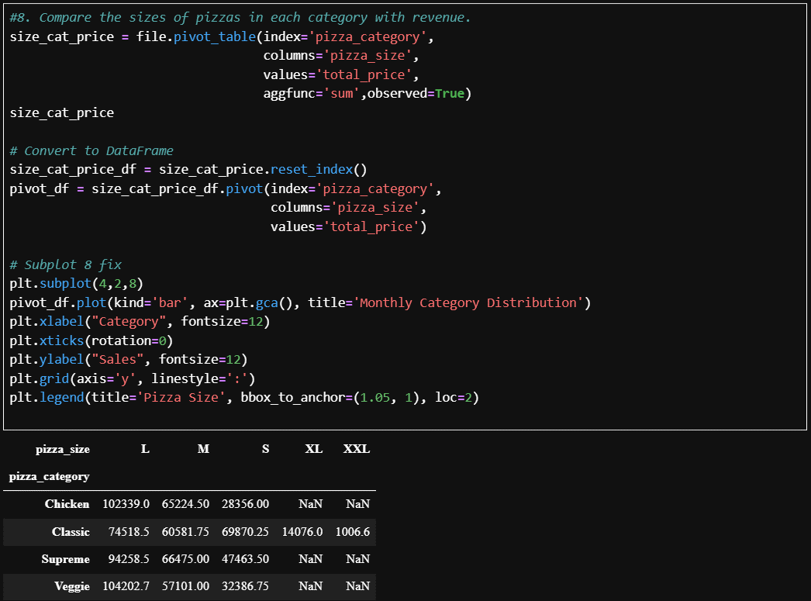
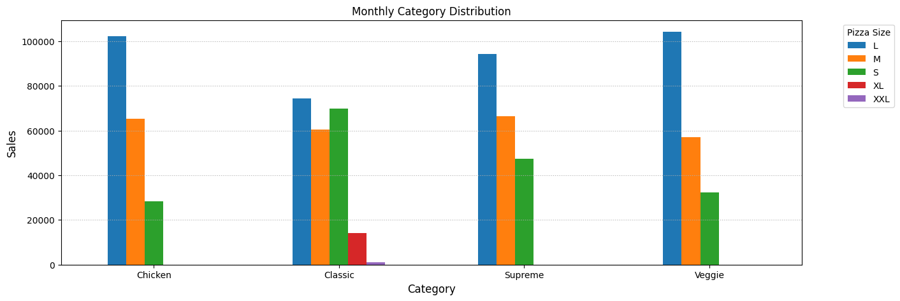
8. Compare the sizes of pizzas in each category.
In every category, 'L' sized pizzas were sold most.
'XL' sized pizzas were not sold in any kind.
'XXL' sized pizzas were sold only in Classic category.

Slide 27
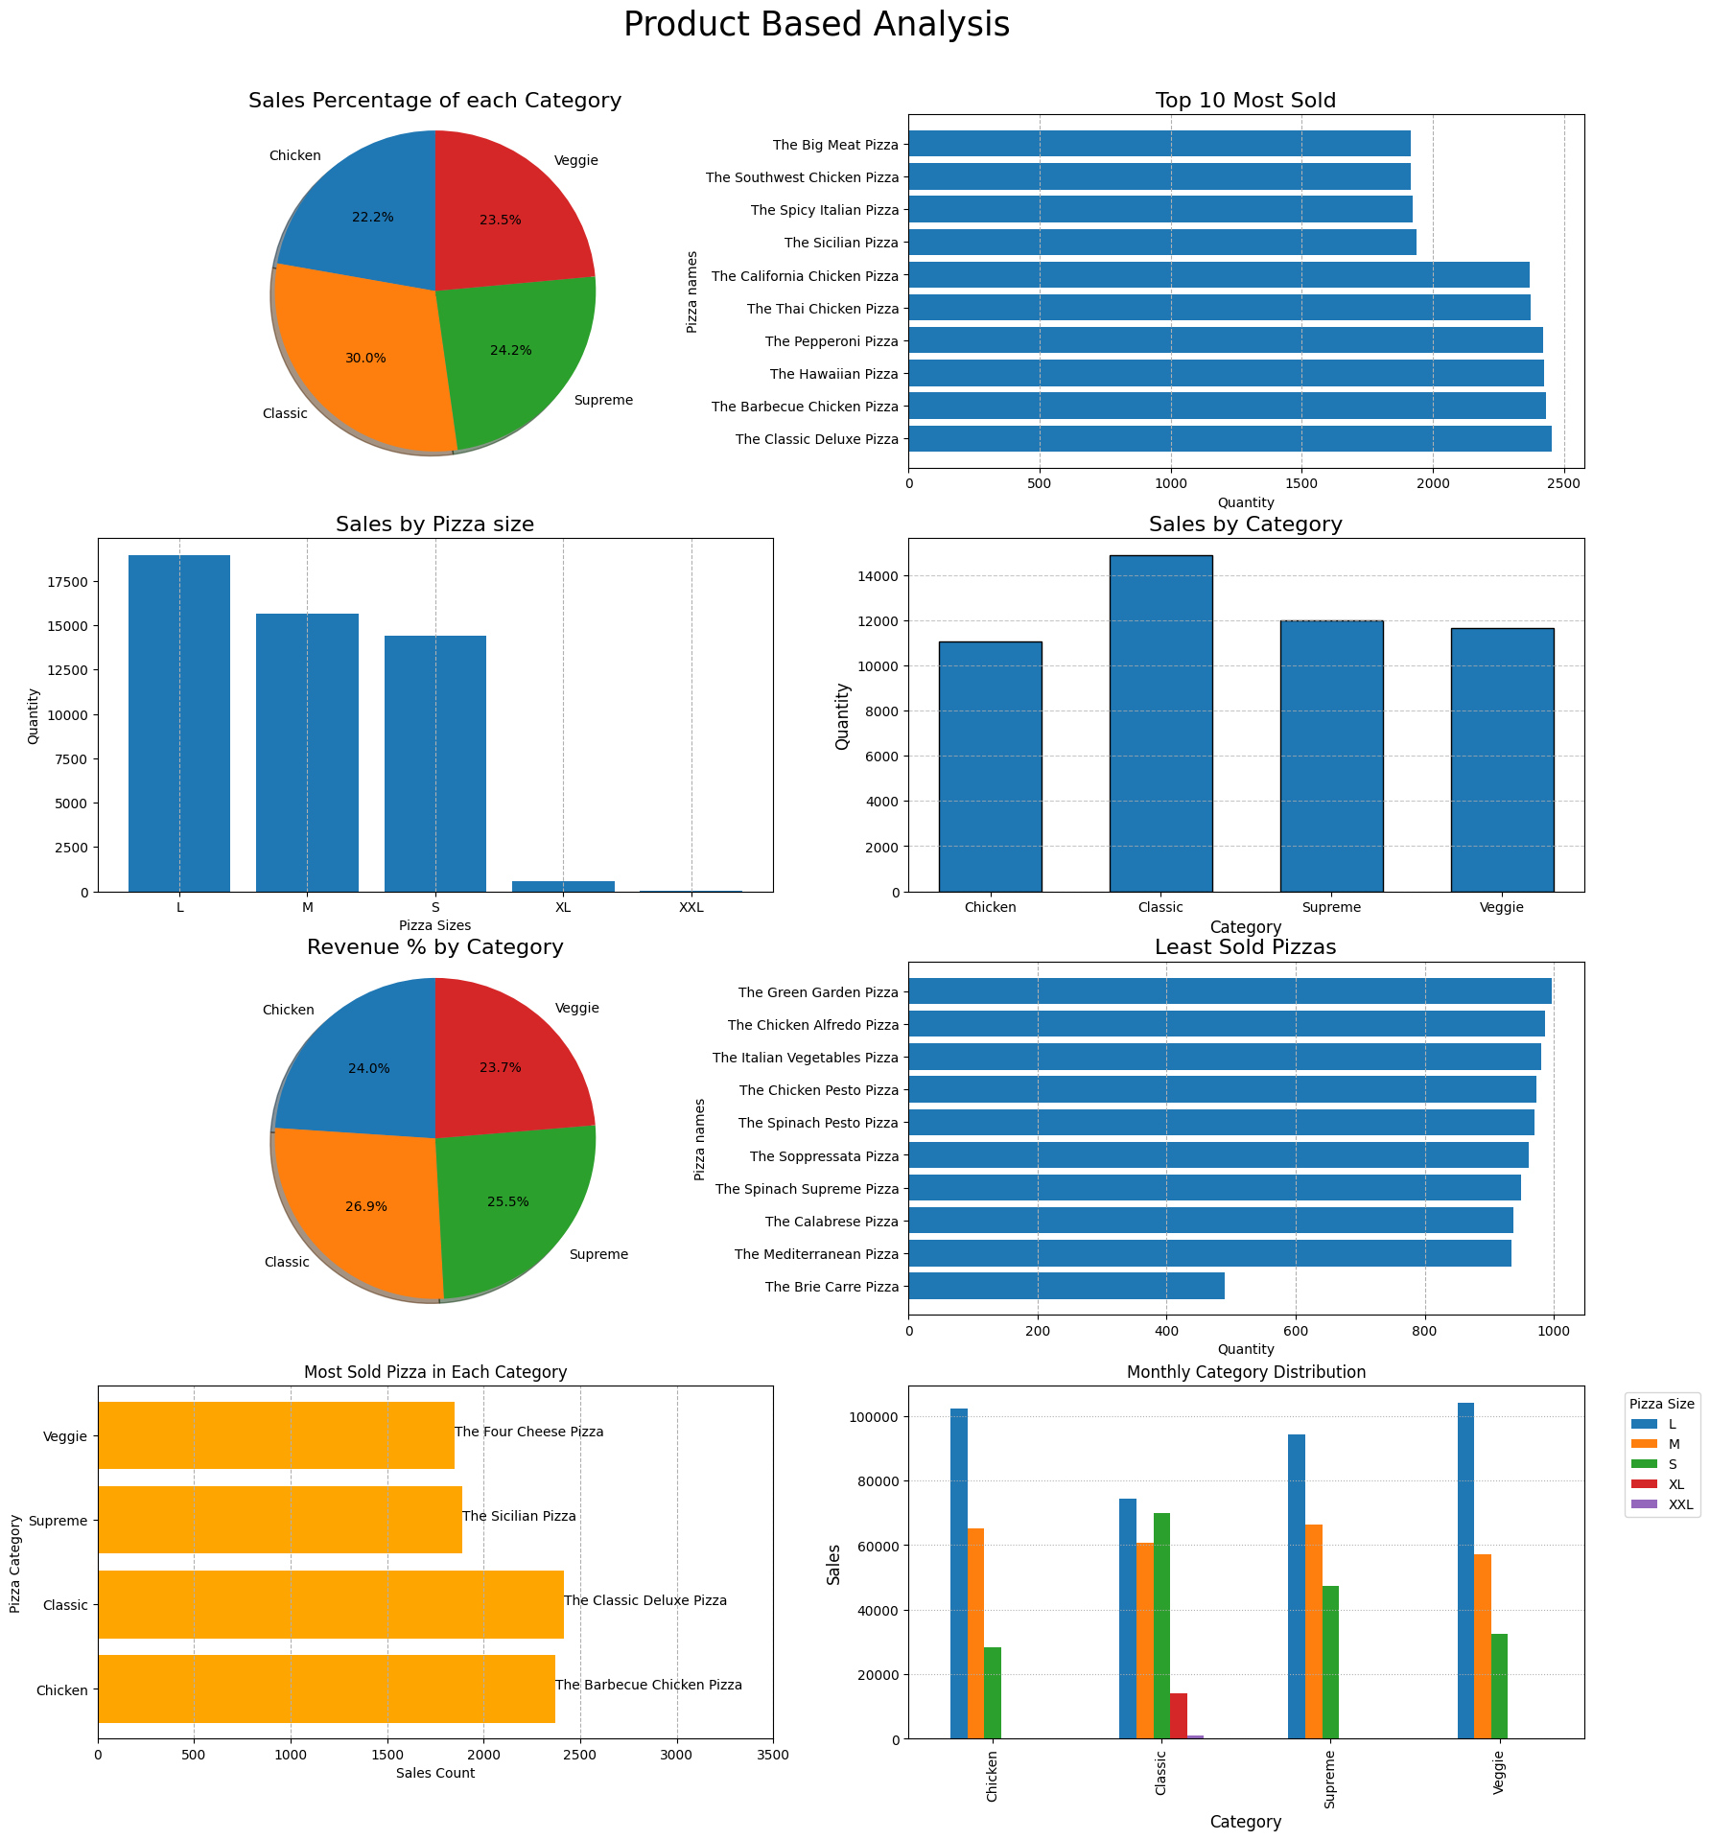
Product Based Analysis Insights:
Sales Percentage by Category:
  1st - Classic = 30%(14579)
  2nd - Supreme = 24.2%(11777)
  3rd - Veggie = 23.5%(11449)
  4th - Chicken = 22.2%(10815)
Classic category pizzas were mostly sold(14888).
Chicken category pizzas were least sold(11050).
Classic category pizzas were generated high revenue(220053.10).
Veggie category pizzas were generated low revenue(193690.45).
Top 10 Most Sold Pizzas:
  The Classic Deluxe Pizza = 2453
  The Barbecue Chicken Pizza = 2432
  The Hawaiian Pizza = 2422
  The Pepperoni Pizza = 2418
  The Thai Chicken Pizza = 2371
  The California Chicken Pizza = 2370
  The Sicilian Pizza = 1938
  The Spicy Italian Pizza = 1924
  The Southwest Chicken Pizza = 1917
  The Big Meat Pizza = 1914
'L' size pizzas were the most preferred pizza size(18956).
'XXL'(28) and 'XL'(552) size pizzas were the least preferred pizza size.
Least Sold Pizzas:
  The Brie Carre Pizza = 490
  The Mediterranean Pizza = 934
  The Calabrese Pizza = 937
  The Spinach Supreme Pizza = 950
  The Soppressata Pizza = 961
  The Spinach Pesto Pizza = 970
  The Chicken Pesto Pizza = 973
  The Italian Vegetables Pizza = 981
  The Chicken Alfredo Pizza = 987
  The Green Garden Pizza = 997
Most Sold Pizza in Each Category
  Chicken - The Barbecue Chicken Pizza - 2372
  Classic - The Classic Deluxe Pizza - 2416
  Supreme - The Sicilian Pizza - 1887
  Veggie - The Four Cheese Pizza - 1850
In every category, 'L' sized pizzas were sold most.
'XL' sized pizzas were not sold in any kind.
'XXL' sized pizzas were sold only in Classic category.

Slide 28
Thank You…!
Analysis by:
Loganathan R

